Slide 1
Percentage of Contributing Factors affecting Climate Actions among Students
Survey Findings
Learning environment are necessary for student’s knowledge
Knowledge about climate change are necessary for affective factors development
Affective factors are necessary for the development of students’ intention towards pro-environmental behaviour
Learning environment (LE)
33%
Cognitive
39%
Affective
71%
Intention towards climate action
Formal
Non-formal
Informal
Causes
Effects
Mitigation
Attitude
Sub. norm
P.B.Control
Values
Passive
Active
Socially
responsible
62%
37%
74%
64%
72%
30%
69%
68%
79%
90%
84%
98%
74%
Formal LE :
Consist of pedagogy in science class, the content in science textbook and practical book and assessment on science subject
Non-formal LE :
Education outside of classroom such as extra curricular activities (schools club / society) and school facilities and rules & regulations that help to promote climate action.
Informal LE contributes the most :
Visits to science center, parks, museum, and social communication through fb, twitter, Instagram, blog)
Cognitive – knowledge about climate change on the causes, the effects and mitigation of climate change contributes the most to the cognitive factors.
Attitude - the feelings, beliefs, and behaviors that students have regarding taking action to address climate change
Subjective norm (norm set by family and community)
Perceived behavioural control (ability to perform the behaviour)
Values contributes largest to affective that will contribute to student’s intention to behave pro-environmentally
The eight civic values on climate change contribute 89% of affective factors are empathy, responsible, justice, co-operation, equality, altruistic, respect, and integrity.
Passive action is when students adopt PEB (electrical-saving, water-saving, and recycling behaviour) without being asked. Example: off the lights when not used.
Active action is when students encourage community around them to adopt PEB. Example: distributing flyers.
Socially responsible is when the student give suggestions to the public on how to perform climate action. Example: Giving tips on water-saving behaviour to the public through social media

Slide 2
RECOMMENDATIONS FOR INTERVENTION
Empower the Teaching and Learning of Climate Change
Enhance Teaching Competencies
Incorporate civic values related to ecological awareness in formal and non-formal curriculum standard.
Create information corner on local cases on climate change crisis.
Integrate augmented reality based on local case in the teaching and learning of climate change.
Create a students’ profile on climate change competencies .
Create teaching guideline on climate change education competencies.
Create climate change narratives as a multi-discipline subject matter- in “Professional Learning Community” (PLC) activities.
Community Empowerment
Harmonization School Environment
Extend green school concept to carbon footprint.
Create guidelines and inventory inculcating civic values related to ecological awareness.
Cultivate a sense of responsibility for the environment by encouraging actions such as reducing waste, conserving energy, and adopting sustainable practices in daily life.
Media Collaboration
Research and Development in Climate Change Education
Increase story scripts / animation on local case studies on topic of climate change on social media, digital and printed media platform .
Monitor and evaluate content on climate change in media.
Enhance research activities and increase research grant allocation.
Integrate research findings in climate change education activities
Conduct critical evaluation on climate change education intervention activities.

Slide 3
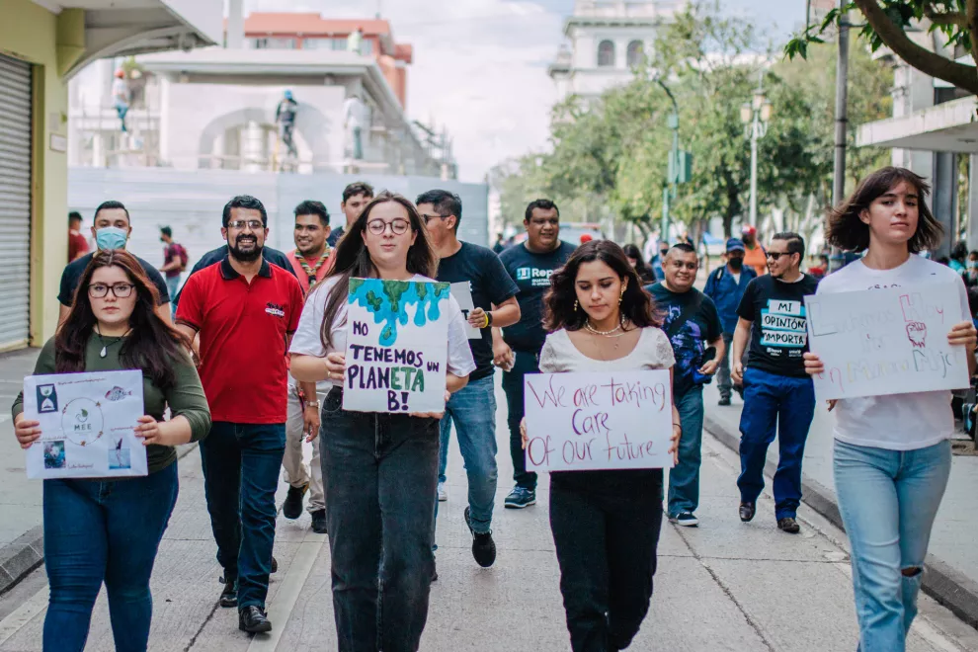
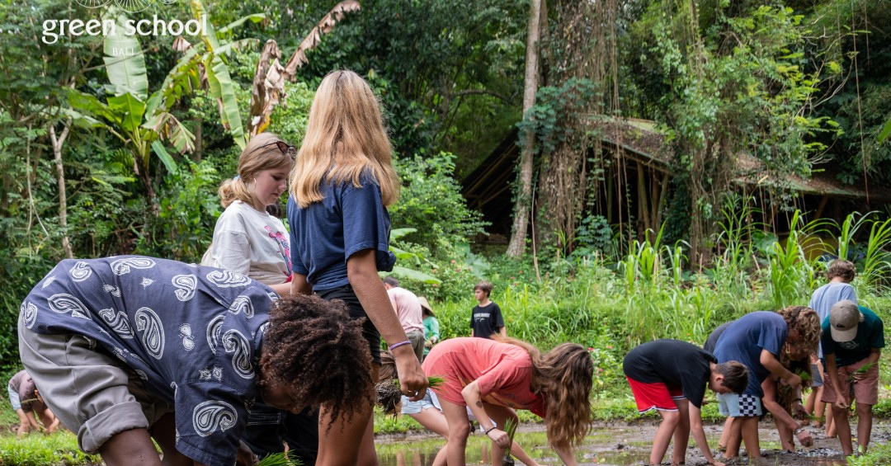
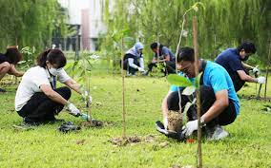
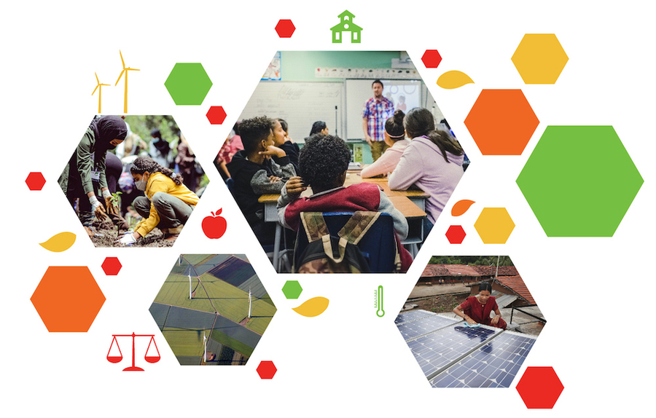
RECOMMENDATIONS FOR INTERVENTION
Empower the Teaching and Learning of Climate Change
Enhance Teaching Competencies
Incorporate civic values related to ecological awareness in formal and non-formal curriculum standard.
Create information corner on local cases on climate change crisis.
Integrate augmented reality based on local case in the teaching and learning of climate change.
Create a students’ profile on climate change competencies .
Create teaching guideline on climate change education competencies.
Create climate change narratives as a multi-discipline subject matter- in “Professional Learning Community” (PLC) activities.
Community Empowerment
Harmonization School Environment
Extend green school concept to carbon footprint.
Create guidelines and inventory inculcating civic values related to ecological awareness.
Cultivate a sense of responsibility for the environment by encouraging actions such as reducing waste, conserving energy, and adopting sustainable practices in daily life.
Media Collaboration
Research and Development in Climate Change Education
Increase story scripts / animation on local case studies on topic of climate change on social media, digital and printed media platform .
Monitor and evaluate content on climate change in media.
Enhance research activities and increase research grant allocation.
Integrate research findings in climate change education activities
Conduct critical evaluation on climate change education intervention activities.

